Slide 1



Introduction To Limerick Institute of Technology
Marie Walsh
MathE Project Partners’ Kick-off Meeting
October 28h – 29th, Florence, Italy
Project Number:
2018-1-PT01-KA203-047361

Slide 2
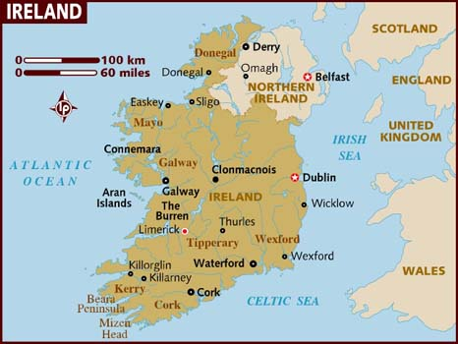
Limerick Institute of Technology: LIT
Institution of Higher Education in Limerick, Ireland.
One of 14 member institutions of the Technological Higher Education Association (THEA).
Campuses in Limerick city, Thurles and Clonmel in County Tipperary, Ennis in County Clare. Approximately 6,500 students.
Project Number:
2018-1-PT01-KA203-047361

Slide 3
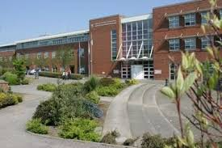
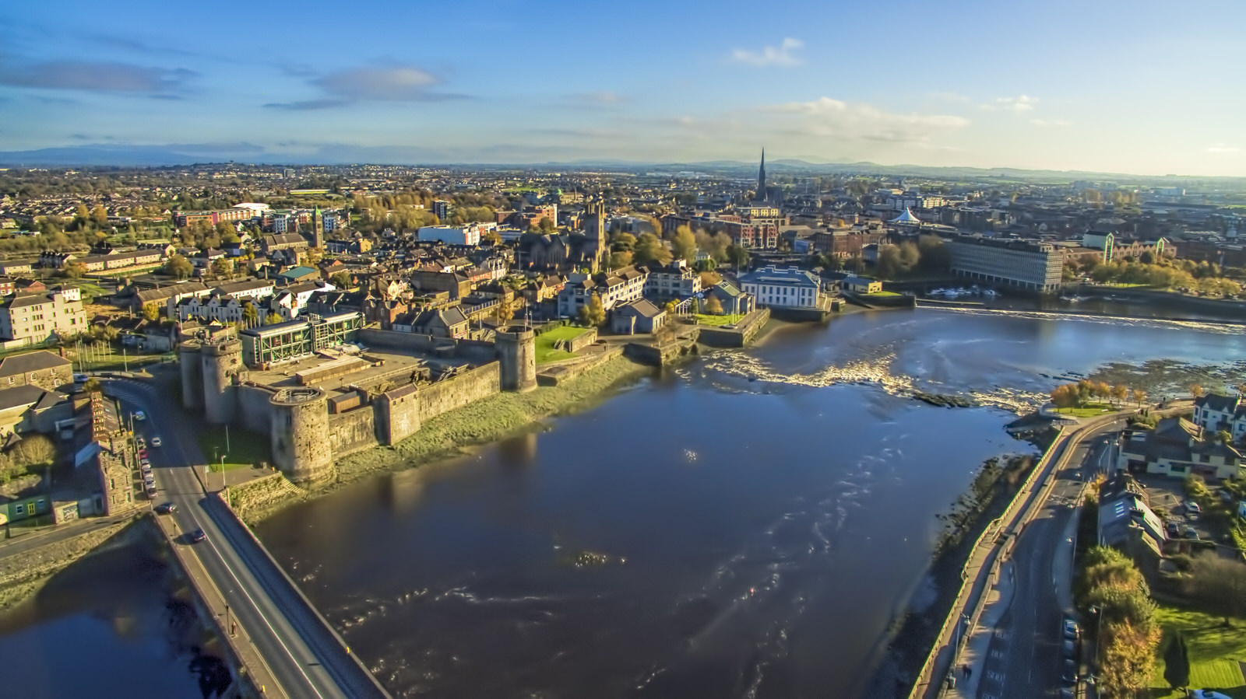
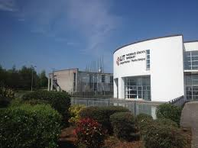
Limerick Institute of Technology: LIT
Main campus LIMERICK city
Base for other STEM and project management THURLES, Tipperary
Project Number:
2018-1-PT01-KA203-047361

Slide 4
Limerick Institute of Technology: LIT
Courses at Level 6 (Higher Certificate) through Level 10 (PhD) whilst also catering for craft apprentices and adult and continuing education.
Many programmes require competency in Mathematics.
Twice named as The Sunday Times Institute of Technology of the Year in The Sunday Times University Guide, in 2008 and again in 2013.
At forefront in ensuring that the region's economy continues to have the requisite array of leading-edge skills demanded by our knowledge-based industries, including communication and mathematical skills.
Project Number:
2018-1-PT01-KA203-047361

Slide 5
Limerick Institute of Technology: LIT
Mathematics is an important component in the STEM programmes which make up the majority of the LIT courses proposed in the project.
LIT has also developed and had approved a maths teaching degree although this has never been offered.
Discipline areas which may participate include: Applied Sciences, Medical Technologies, Engineering, Construction Studies, Business Studies.
Project Number:
2018-1-PT01-KA203-047361

Slide 6
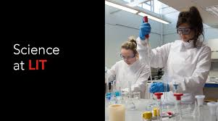
Limerick Institute of Technology: LIT
Approach to Teaching and Learning known as the
Active Learning Philosophy
In every discipline area the core methodology is active and practical: lab work, studio work, case studies, field visits, group assignments, etc.
Embedded in assessment strategies and campus development.
Underpinned by continuous professional staff development, e.g. workshops and an online repository of active learning strategies.
Project Number:
2018-1-PT01-KA203-047361

Slide 7
Limerick Institute of Technology: LIT
Experience in a variety of student interaction models and interactive learning space for all learners.
Problem Based Learning approach used on a number of programmes of study.
Many staff have dedicated interest in teaching and learning approaches and have carried out research and engaged in networks and organisations which address these issues.
LIT lecturers have recognised particular difficulties with mathematics and are supportive of the student learning support unit and its initiatives to enhance teaching and learning in mathematics.
Project Number:
2018-1-PT01-KA203-047361

Slide 8
Limerick Institute of Technology: LIT
RESEARCH, DEVELOPMENT, INNOVATION:
Development Team within RDI implements a wide range of projects in partnership with academic institutes, professional organisations, local and central government, representative organisations, industry and commercial bodies.
Critical areas of focus for the Development Team include Social Enterprise, Sustainable Energy and Rural Development.
Facilitation of research and non-research development, participation in EU funded projects, consultancy activities in public and private sectors, and working closely with academic staff and experts across the fields of expertise within the Institute.
Project Number:
2018-1-PT01-KA203-047361

Slide 9
Limerick Institute of Technology: LIT
Regular participant in EU programmes both as project co-ordinator and project partner.
Has participated in Comenius, Erasmus and Leonardo as well as FP7 and IEE projects: examples include -
Chemistry is all Around Us Network, funded in the framework of the Lifelong Learning Programme – Comenius sub programme – Networks Action
E-learning from Nature, Erasmus+ KA2 project, which looked at the use of digital and other media to promote alternative methods of teaching and learning science.
Project Number:
2018-1-PT01-KA203-047361

Slide 10
Thank You for Your Attention
Marie Walsh
MathE Project Partners’ Kick-off Meeting
October 28h – 29th, Florence, Italy
Project Number:
2018-1-PT01-KA203-047361

